Slide 1
Chapter 11 – File Processing
Outline
11.1 Introduction
11.2 The Data Hierarchy
11.3 Files and Streams
11.4 Creating a Sequential Access File
11.5 Reading Data from a Sequential Access File
11.6 Random Access Files
11.7 Creating a Randomly Accessed File
11.8 Writing Data Randomly to a Randomly Accessed File
11.9 Reading Data Randomly from a Randomly Accessed File
11.10 Case Study: A Transaction-Processing Program

Slide 2
Objectives
In this chapter, you will learn:
  To be able to create, read, write and update files.
  To become familiar with sequential access file processing.
  To become familiar with random-access file processing.

Slide 3
11.1 Introduction
Data files
  Can be created, updated, and processed by C programs
  Are used for permanent storage of large amounts of data
    Storage of data in variables and arrays is only temporary

Slide 4
11.2 The Data Hierarchy
Data Hierarchy:
  Bit – smallest data item
    Value of 0 or 1
  Byte – 8 bits
    Used to store a character
      Decimal digits, letters, and special symbols
  Field – group of characters conveying meaning
    Example: your name
  Record – group of related fields
    Represented by a struct or a class
    Example: In a payroll system, a record for a particular employee that contained his/her identification number, name, address, etc.

Slide 5
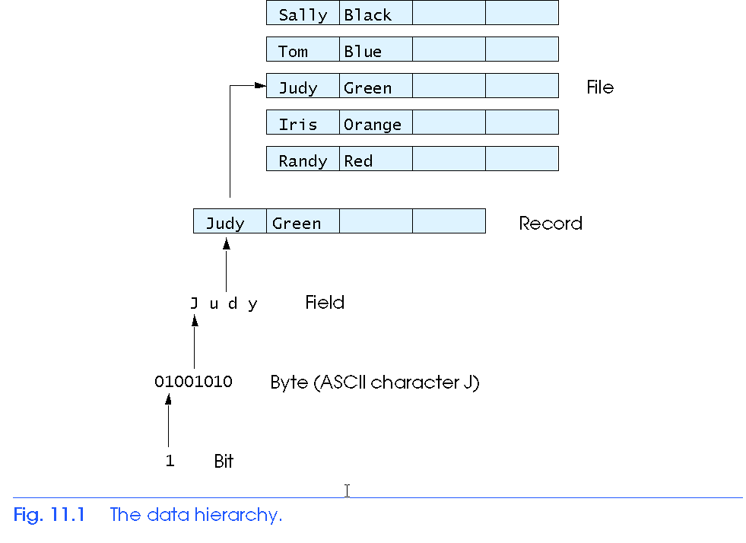
11.2 The Data Hierarchy
Data Hierarchy (continued):
  File – group of related records
    Example: payroll file
  Database – group of related files

Slide 6
11.2 The Data Hierarchy
Data files
  Record key
    Identifies a record to facilitate the retrieval of specific records from a file
  Sequential file
    Records typically sorted by key

Slide 7
11.3 Files and Streams
C views each file as a sequence of bytes
  File ends with the end-of-file marker
    Or, file ends at a specified byte
Stream created when a file is opened
  Provide communication channel between files and programs
  Opening a file returns a pointer to a FILE structure
    Example file pointers:
    stdin - standard input (keyboard)
    stdout - standard output (screen)
    stderr - standard error (screen)

Slide 8
11.3 Files and Streams
FILE structure
  File descriptor
    Index into operating system array called the open file table
  File Control Block (FCB)
    Found in every array element, system uses it to administer the file

Slide 9
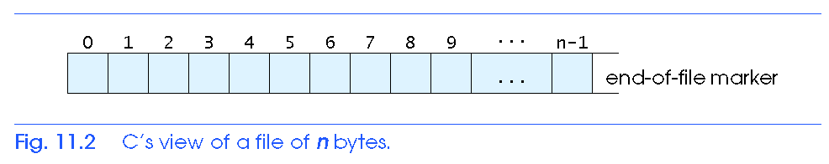
11.3 Files and Streams

Slide 10
11.3 Files and Streams
Read/Write functions in standard library
  fgetc
    Reads one character from a file
    Takes a FILE pointer as an argument
    fgetc( stdin ) equivalent to getchar()
  fputc
    Writes one character to a file
    Takes a FILE pointer and a character to write as an argument
    fputc( 'a', stdout ) equivalent to putchar( 'a' )
  fgets
    Reads a line from a file
  fputs
    Writes a line to a file
  fscanf / fprintf
    File processing equivalents of scanf and printf

Slide 11
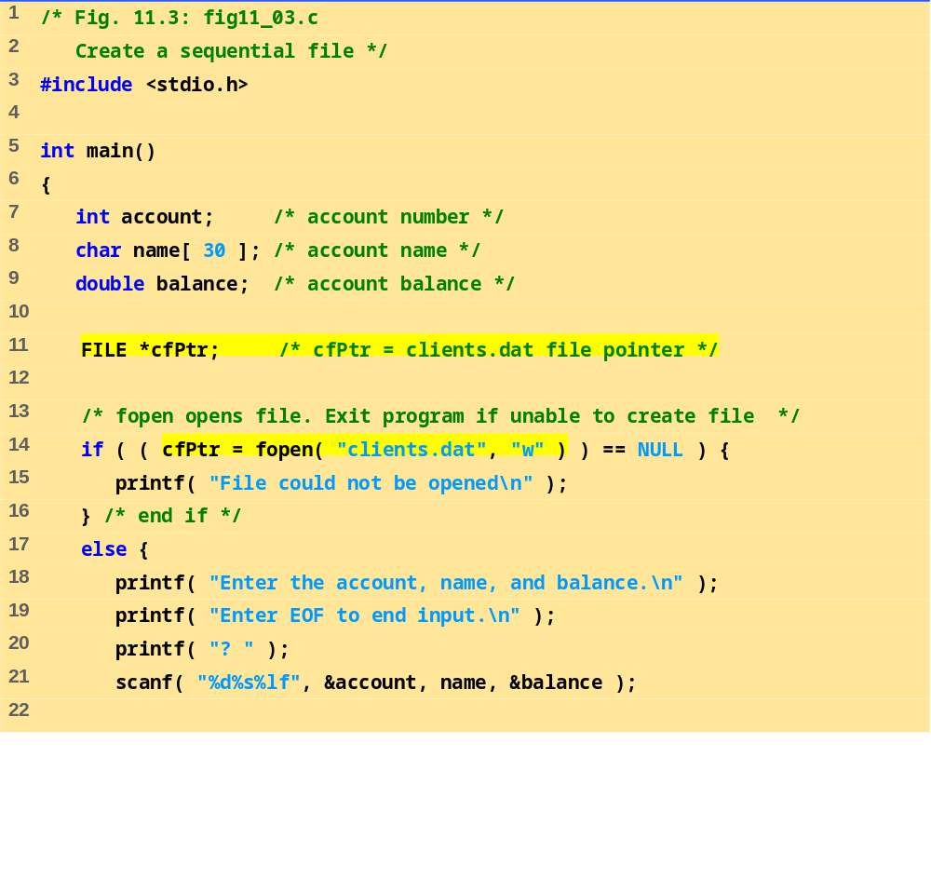
fig11_03.c (1 of 2)

Slide 12
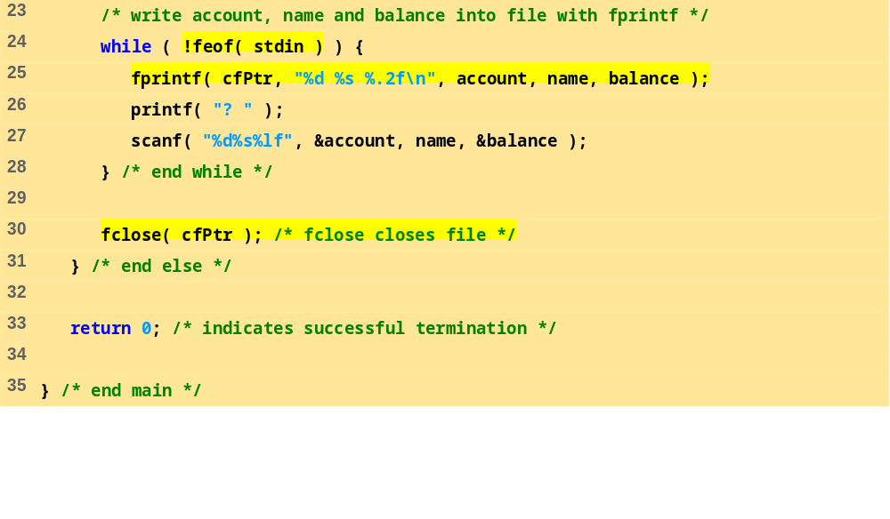
fig11_03.c (2 of 2)
Program Output
Enter the account, name, and balance.
Enter EOF to end input.
? 100 Jones 24.98
? 200 Doe 345.67
? 300 White 0.00
? 400 Stone -42.16
? 500 Rich 224.62
? ^Z

Slide 13
11.4 Creating a Sequential Access File
C imposes no file structure
  No notion of records in a file
  Programmer must provide file structure
Creating a File
  FILE *cfPtr;
    Creates a FILE pointer called cfPtr
  cfPtr = fopen(“clients.dat", “w”);
    Function fopen returns a FILE pointer to file specified
    Takes two arguments – file to open and file open mode
    If open fails, NULL returned

Slide 14
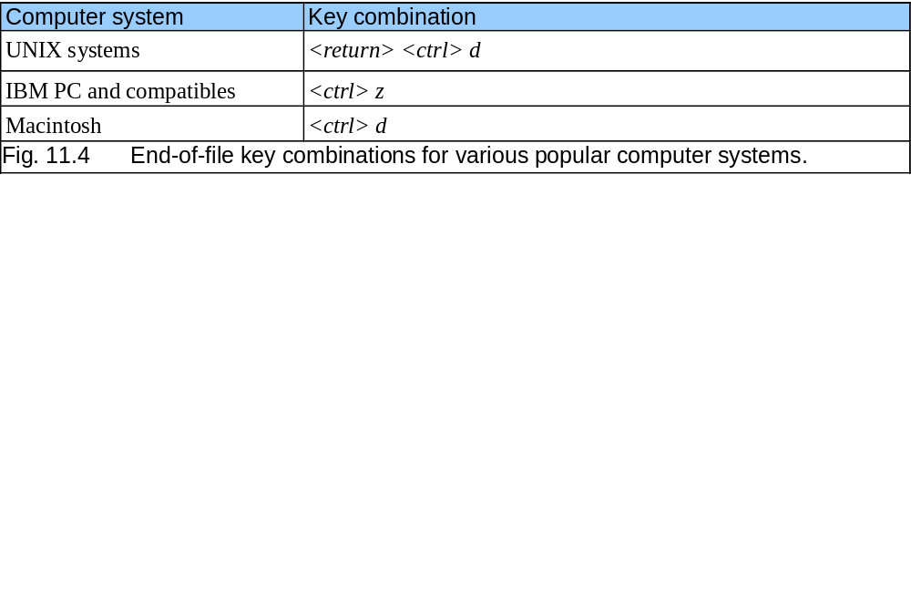
11.4 Creating a Sequential Access File

Slide 15
11.4 Creating a Sequential Access File
  fprintf
    Used to print to a file
    Like printf, except first argument is a FILE pointer (pointer to the file you want to print in)
  feof( FILE pointer )
    Returns true if end-of-file indicator (no more data to process) is set for the specified file
  fclose( FILE pointer )
    Closes specified file
    Performed automatically when program ends
    Good practice to close files explicitly
Details
  Programs may process no files, one file, or many files
  Each file must have a unique name and should have its own pointer

Slide 16
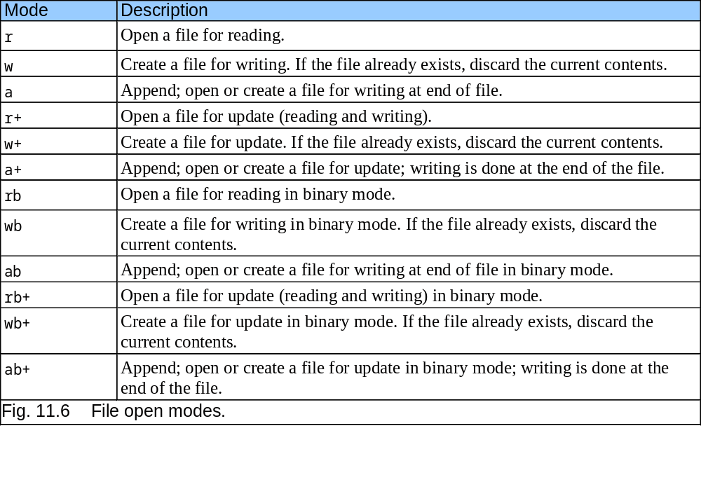
11.4 Creating a Sequential Access File

Slide 17
11.5 Reading Data from a Sequential Access File
Reading a sequential access file
  Create a FILE pointer, link it to the file to read
    cfPtr = fopen( “clients.dat", "r" );
  Use fscanf to read from the file
    Like scanf, except first argument is a FILE pointer
    fscanf( cfPtr, "%d%s%f", &accounnt, name, &balance );
  Data read from beginning to end
  File position pointer
    Indicates number of next byte to be read / written
    Not really a pointer, but an integer value (specifies byte location)
    Also called byte offset
  rewind( cfPtr )
    Repositions file position pointer to beginning of file (byte 0)

Slide 18
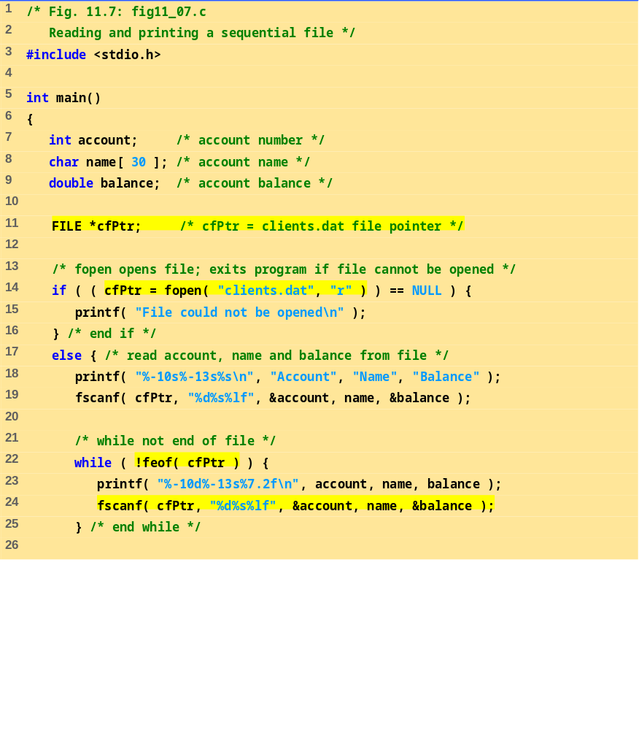
fig11_07.c (1 of 2)

Slide 19
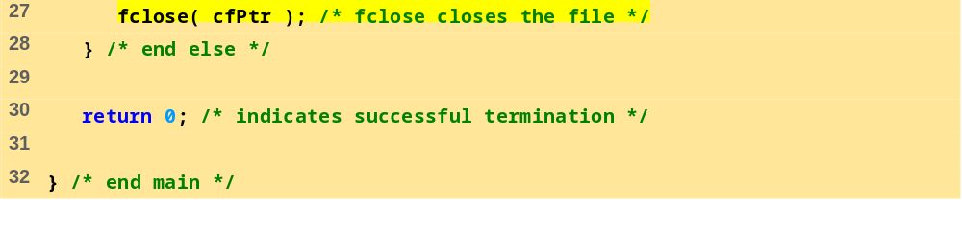
fig11_07.c (2 of 2)
Account Name Balance
100 Jones 24.98
200 Doe 345.67
300 White 0.00
400 Stone -42.16
500 Rich 224.62

Slide 20
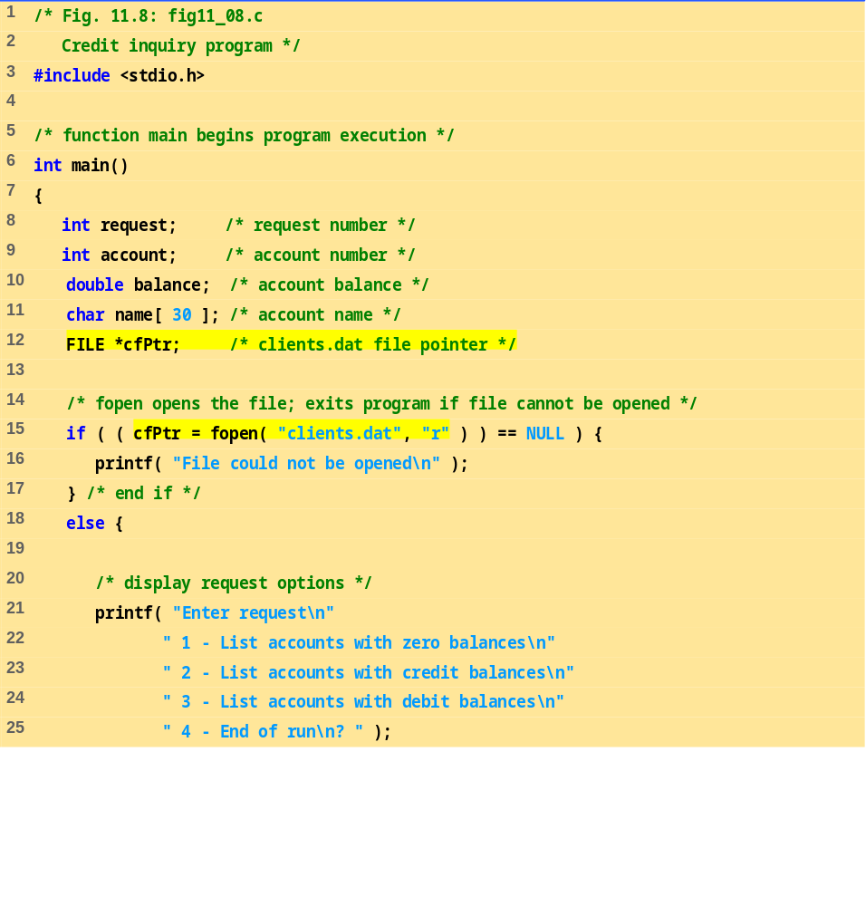
fig11_08.c (1 of 5)

Slide 21
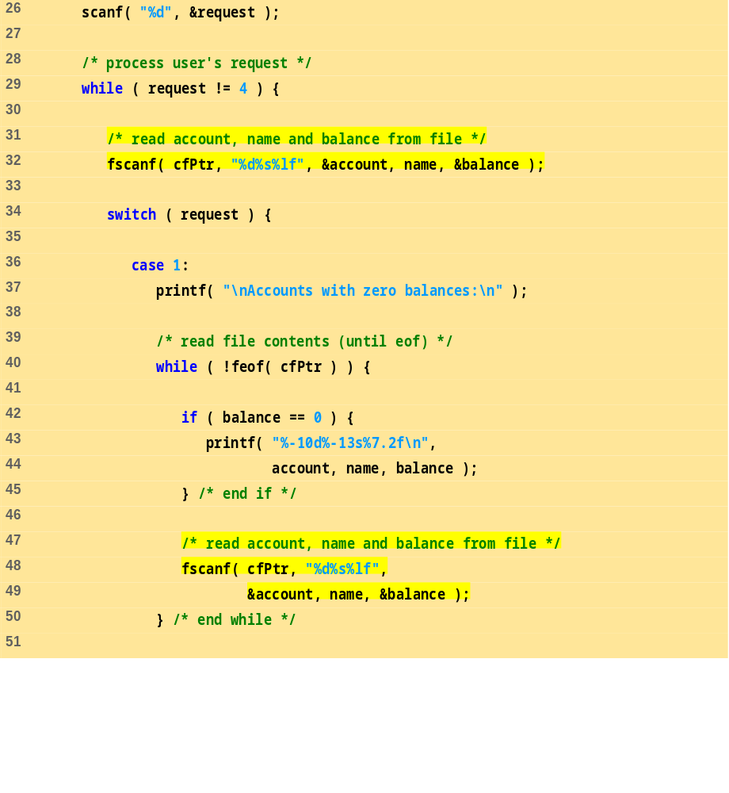
fig11_08.c (2 of 5)

Slide 22
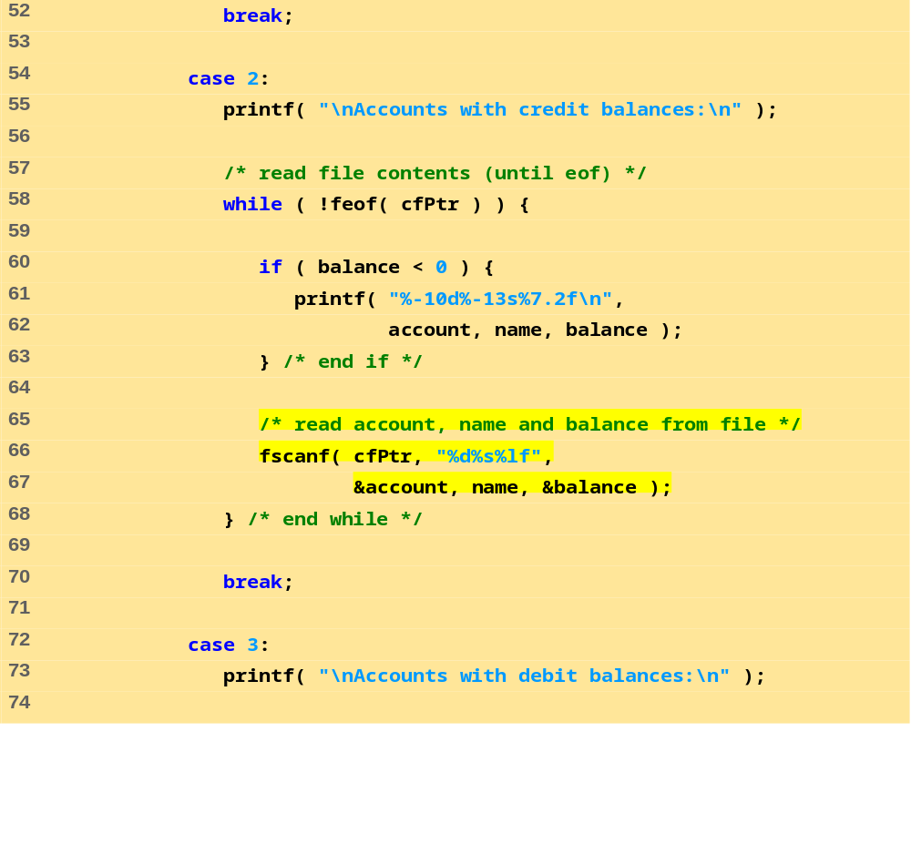
fig11_08.c (3 of 5)

Slide 23
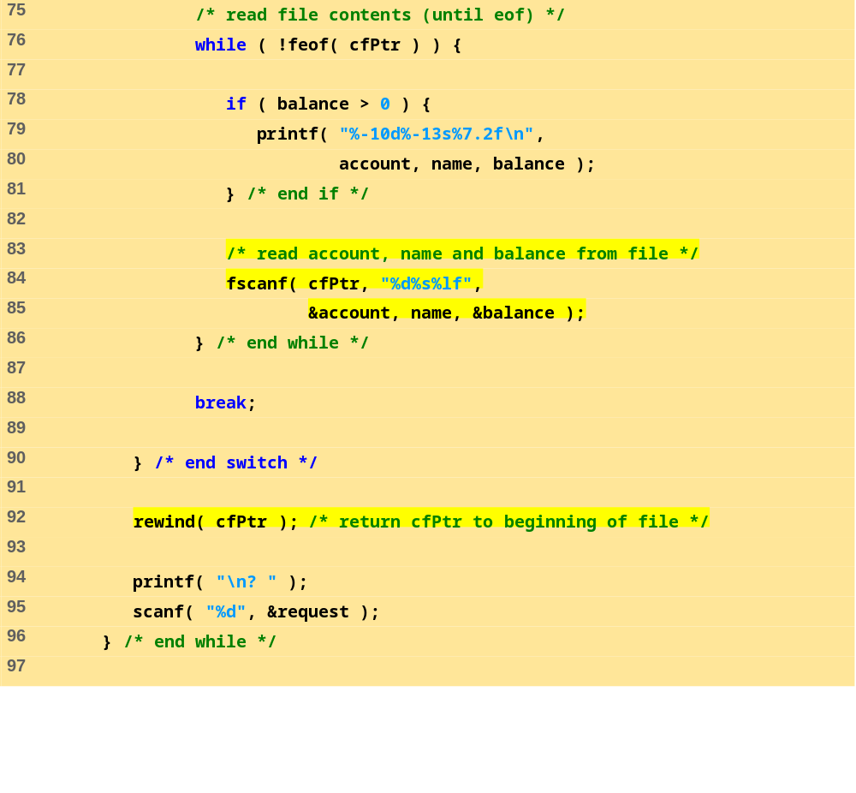
fig11_08.c (4 of 5)

Slide 24
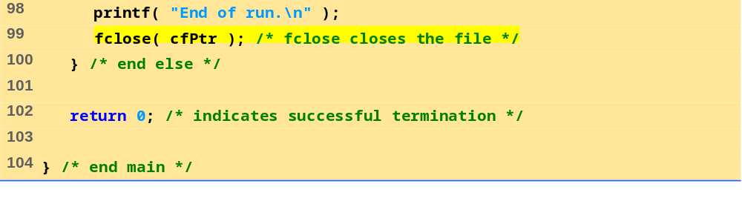
fig11_08.c (5 of 5)
Program Output
Enter request
1 - List accounts with zero balances
2 - List accounts with credit balances
3 - List accounts with debit balances
4 - End of run
? 1
Accounts with zero balances:
300 White 0.00
? 2
Accounts with credit balances:
400 Stone -42.16
? 3
Accounts with debit balances:
100 Jones 24.98
200 Doe 345.67
500 Rich 224.62
? 4
End of run.

Slide 25
11.5 Reading Data from a Sequential Access File
Sequential access file
  Cannot be modified without the risk of destroying other data
  Fields can vary in size
    Different representation in files and screen than internal representation
    1, 34, -890 are all ints, but have different sizes on disk
300 White 0.00 400 Jones 32.87 (old data in file)
If we want to change White's name to Worthington,
300 Worthington 0.00
300 White 0.00 400 Jones 32.87
Data gets overwritten
300 Worthington 0.00ones 32.87

Slide 26
11.6 Random-Access Files
Random access files
  Access individual records without searching through other records
  Instant access to records in a file
  Data can be inserted without destroying other data
  Data previously stored can be updated or deleted without overwriting
Implemented using fixed length records
  Sequential files do not have fixed length records
0
100
200
300
400
500
}
byte offsets
}
}
}
}
}
}
100
bytes
100
bytes
100
bytes
100
bytes
100
bytes
100
bytes

Slide 27
11.7 Creating a Randomly Accessed File
Data in random access files
  Unformatted (stored as "raw bytes")
    All data of the same type (ints, for example) uses the same amount of memory
    All records of the same type have a fixed length
    Data not human readable

Slide 28
11.7 Creating a Randomly Accessed File
Unformatted I/O functions
  fwrite
    Transfer bytes from a location in memory to a file
  fread
    Transfer bytes from a file to a location in memory
  Example:
    fwrite( &number, sizeof( int ), 1, myPtr );
    &number – Location to transfer bytes from
    sizeof( int ) – Number of bytes to transfer
    1 – For arrays, number of elements to transfer
      In this case, "one element" of an array is being transferred
    myPtr – File to transfer to or from

Slide 29
11.7 Creating a Randomly Accessed File
Writing structs
  fwrite( &myObject, sizeof (struct myStruct), 1, myPtr );
  sizeof – returns size in bytes of object in parentheses
To write several array elements
  Pointer to array as first argument
  Number of elements to write as third argument

Slide 30
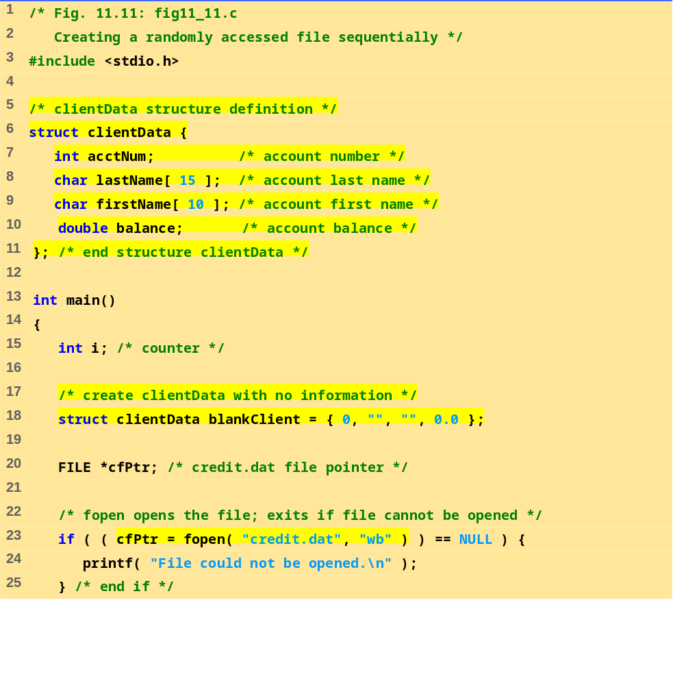
fig11_11.c (1 of 2)

Slide 31
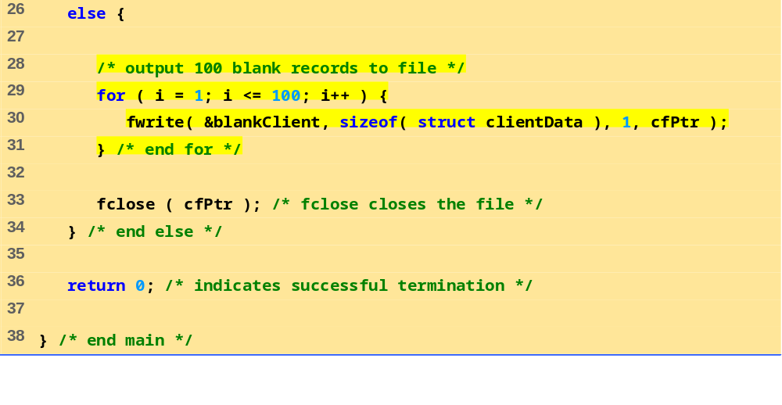
fig11_11.c (2 of 2)

Slide 32
11.8 Writing Data Randomly to a Randomly Accessed File
fseek
  Sets file position pointer to a specific position
  fseek( pointer, offset, symbolic_constant );
    pointer – pointer to file
    offset – file position pointer (0 is first location)
    symbolic_constant – specifies where in file we are reading from
    SEEK_SET – seek starts at beginning of file
    SEEK_CUR – seek starts at current location in file
    SEEK_END – seek starts at end of file

Slide 33
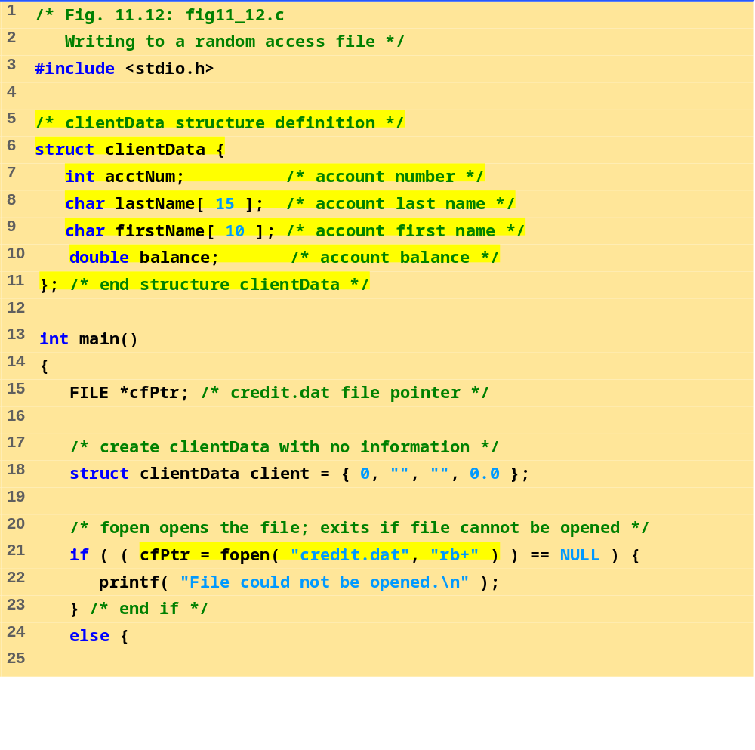
fig11_12.c (1 of 3)

Slide 34
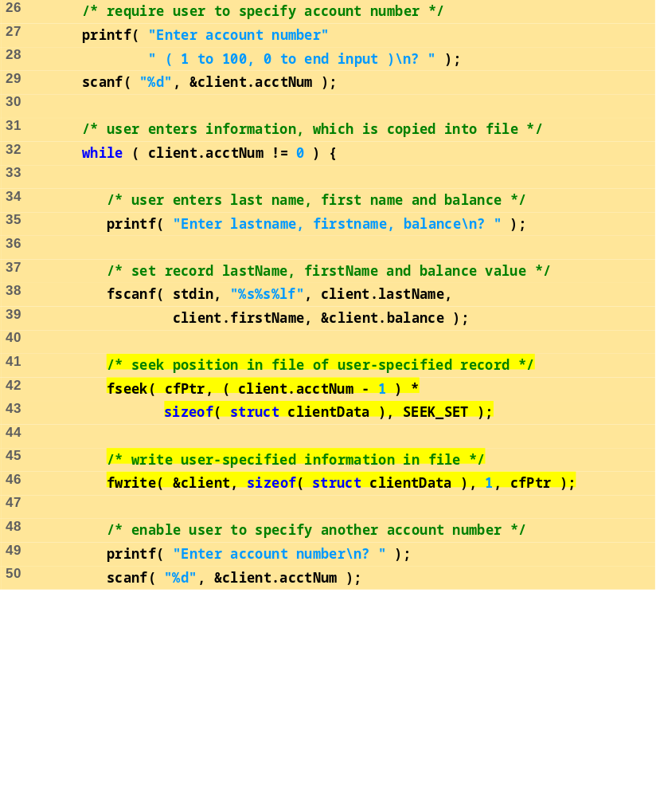
fig11_12.c (2 of 3)

Slide 35
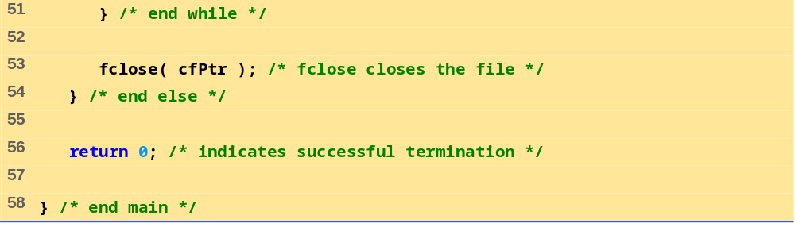
fig11_12.c (3 of 3)
Program Output
Enter account number ( 1 to 100, 0 to end input )
? 37
Enter lastname, firstname, balance
? Barker Doug 0.00
Enter account number
? 29
Enter lastname, firstname, balance
? Brown Nancy -24.54
Enter account number
? 96
Enter lastname, firstname, balance
? Stone Sam 34.98
Enter account number
? 88
Enter lastname, firstname, balance
? Smith Dave 258.34
Enter account number
? 33
Enter lastname, firstname, balance
? Dunn Stacey 314.33
Enter account number
? 0

Slide 36
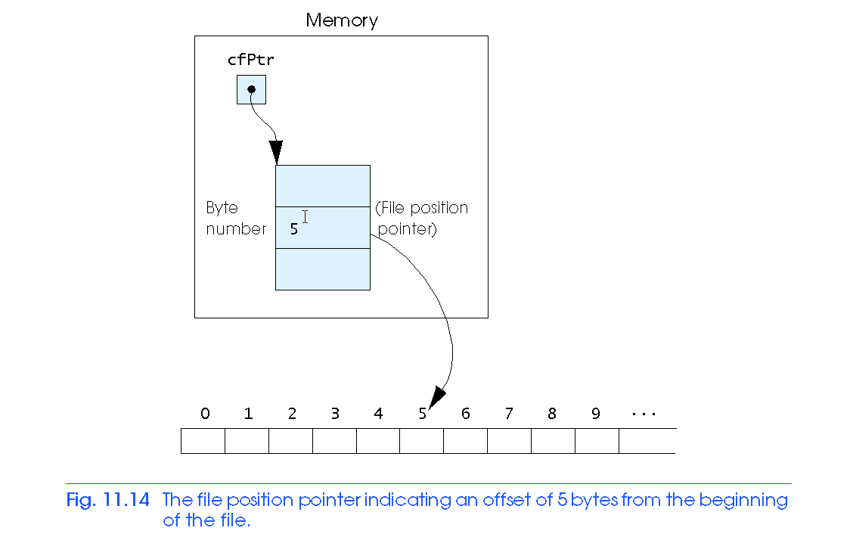
11.8 Writing Data Randomly to a Randomly Accessed File

Slide 37
11.9 Reading Data Randomly from a Randomly Accessed File
fread
  Reads a specified number of bytes from a file into memory
    fread( &client, sizeof (struct clientData), 1, myPtr );
  Can read several fixed-size array elements
    Provide pointer to array
    Indicate number of elements to read
  To read multiple elements, specify in third argument

Slide 38
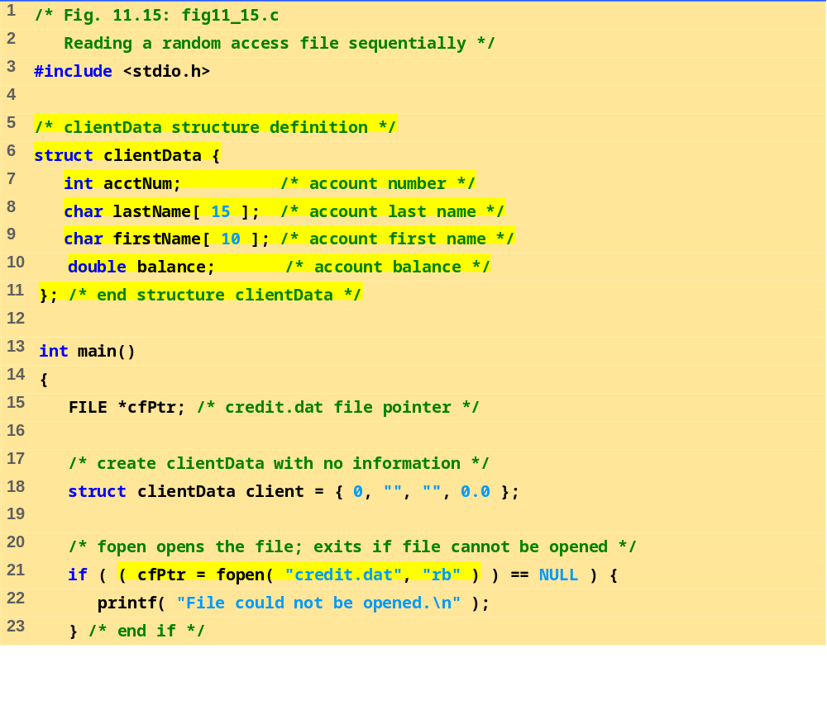
fig11_15.c (1 of 2)

Slide 39
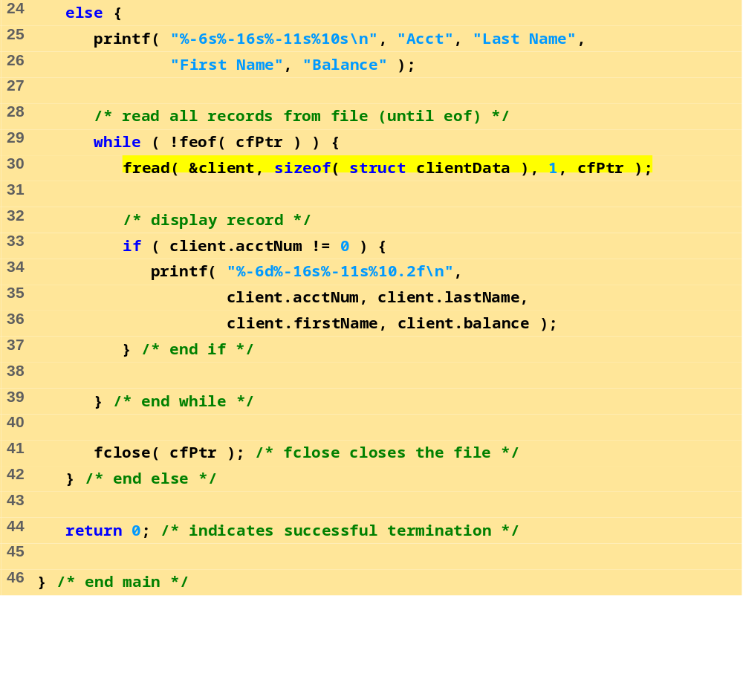
fig11_15.c (2 of 2)

Slide 40
Acct Last Name First Name Balance
29 Brown Nancy -24.54
33 Dunn Stacey 314.33
37 Barker Doug 0.00
88 Smith Dave 258.34
96 Stone Sam 34.98
Program Output

Slide 41
11.10 Case Study: A Transaction Processing Program
This program
  Demonstrates using random access files to achieve instant access processing of a bank’s account information
We will
  Update existing accounts
  Add new accounts
  Delete accounts
  Store a formatted listing of all accounts in a text file

Slide 42
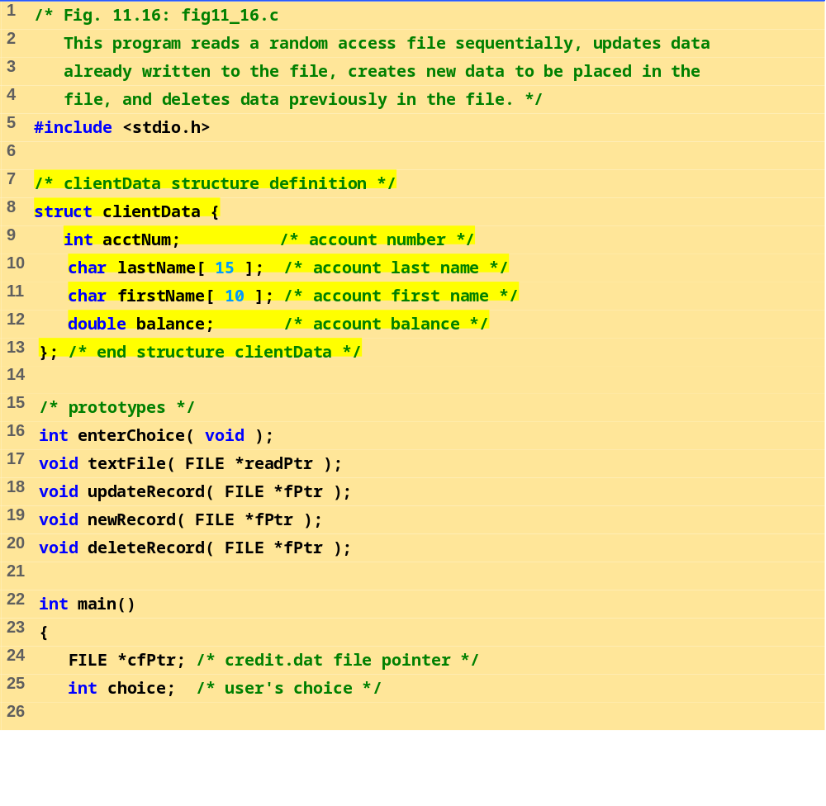
fig11_16.c (1 of 11)

Slide 43
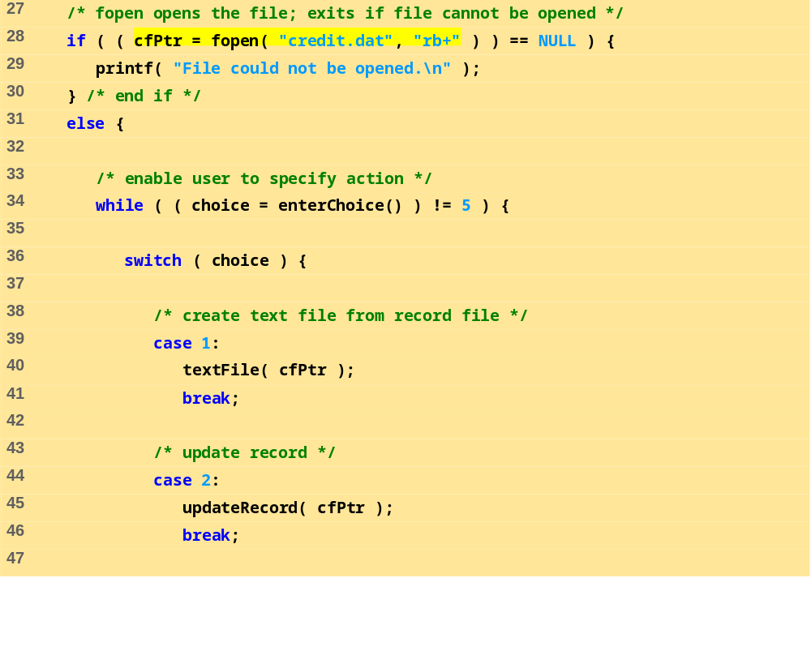
fig11_16.c (2 of 11)

Slide 44
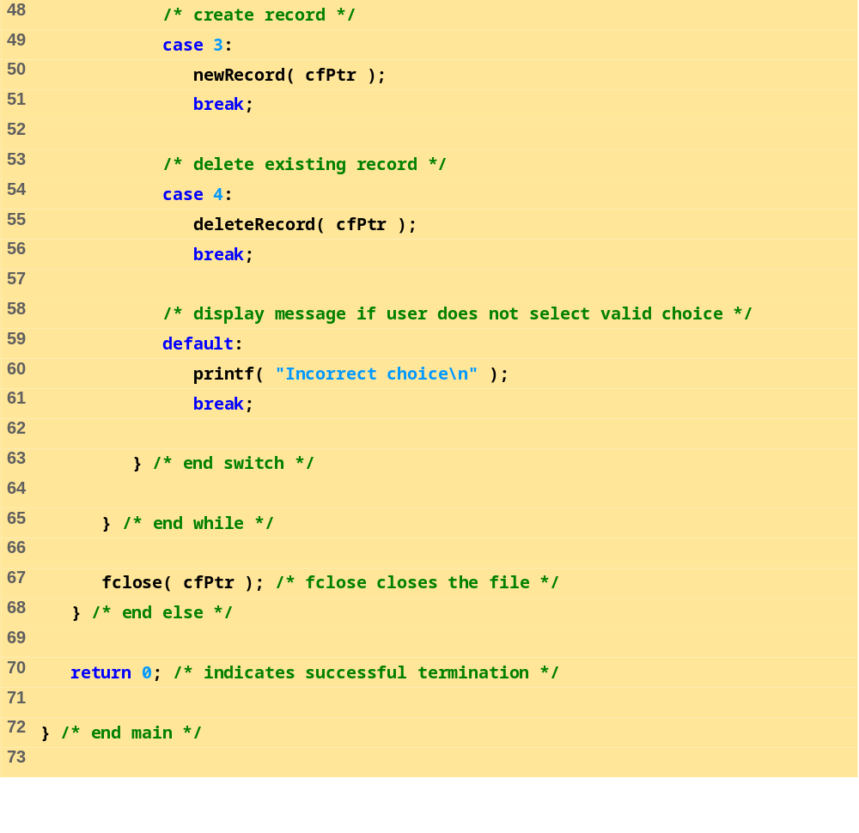
fig11_16.c (3 of 11)

Slide 45
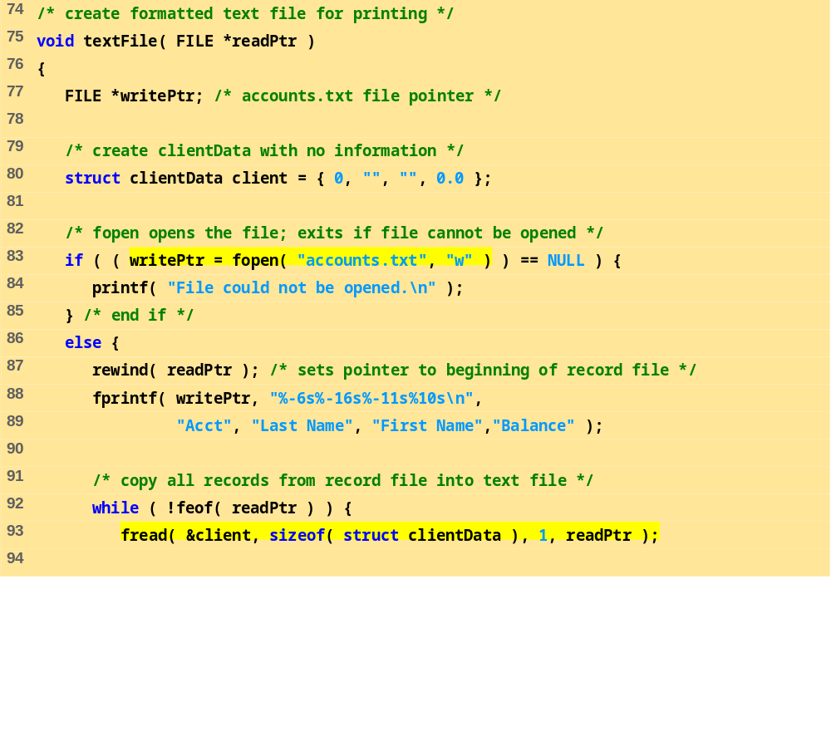
fig11_16.c (4 of 11)

Slide 46
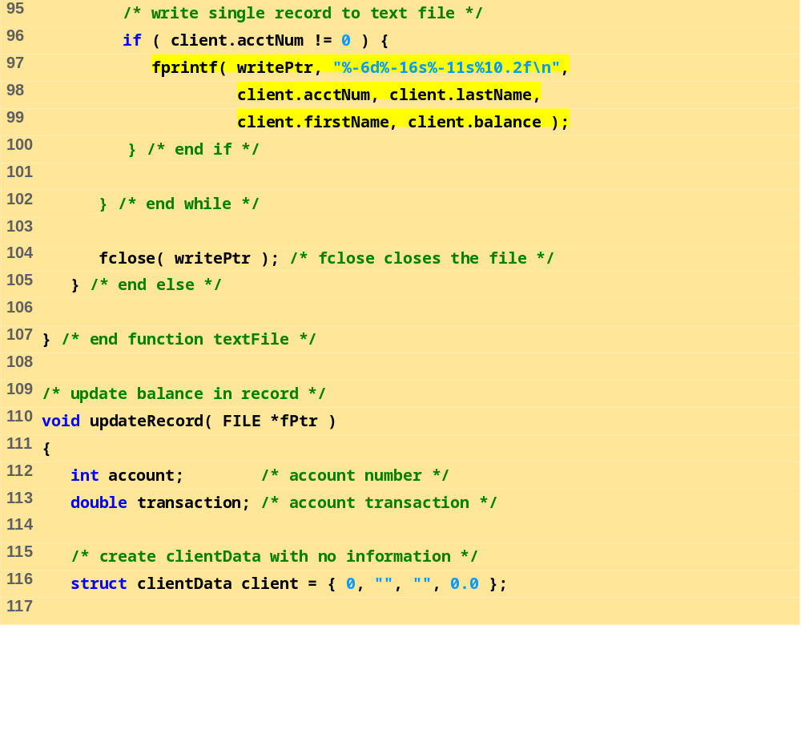
fig11_16.c (5 of 11)

Slide 47
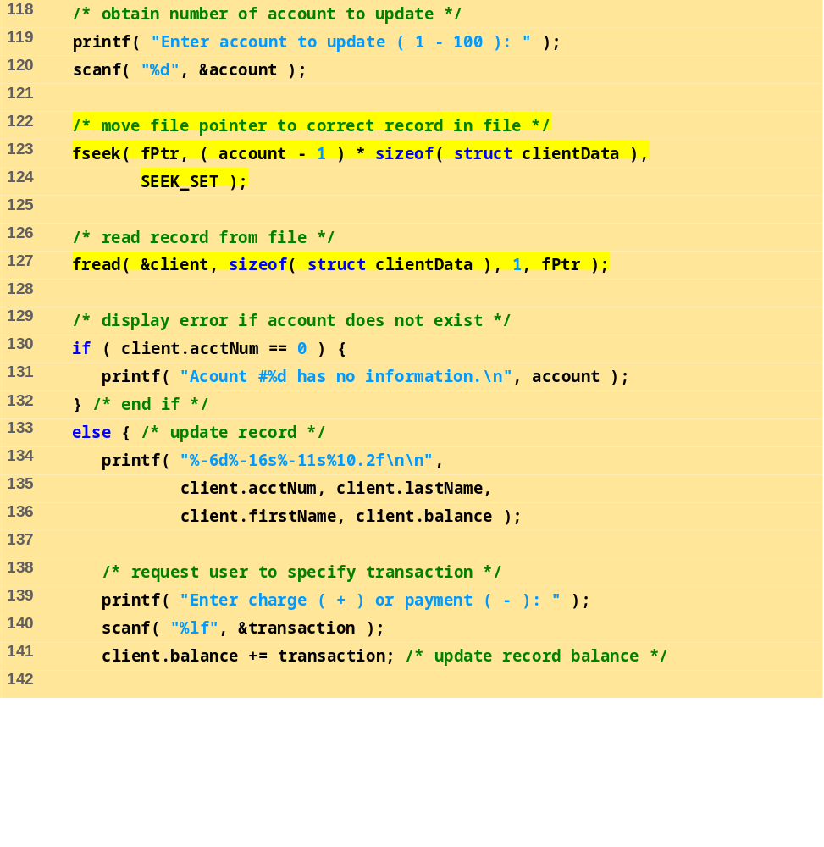
fig11_16.c (6 of 11)

Slide 48
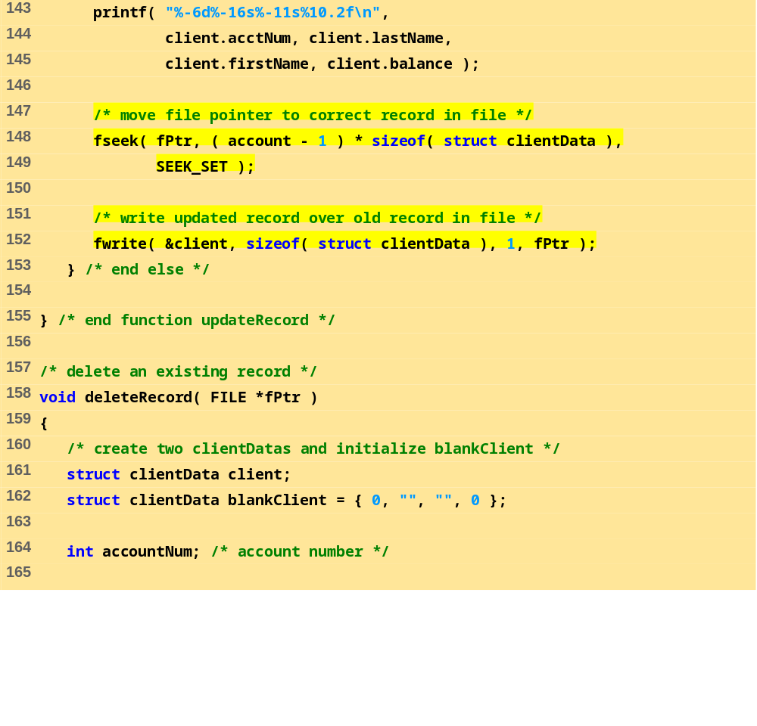
fig11_16.c (7 of 11)

Slide 49
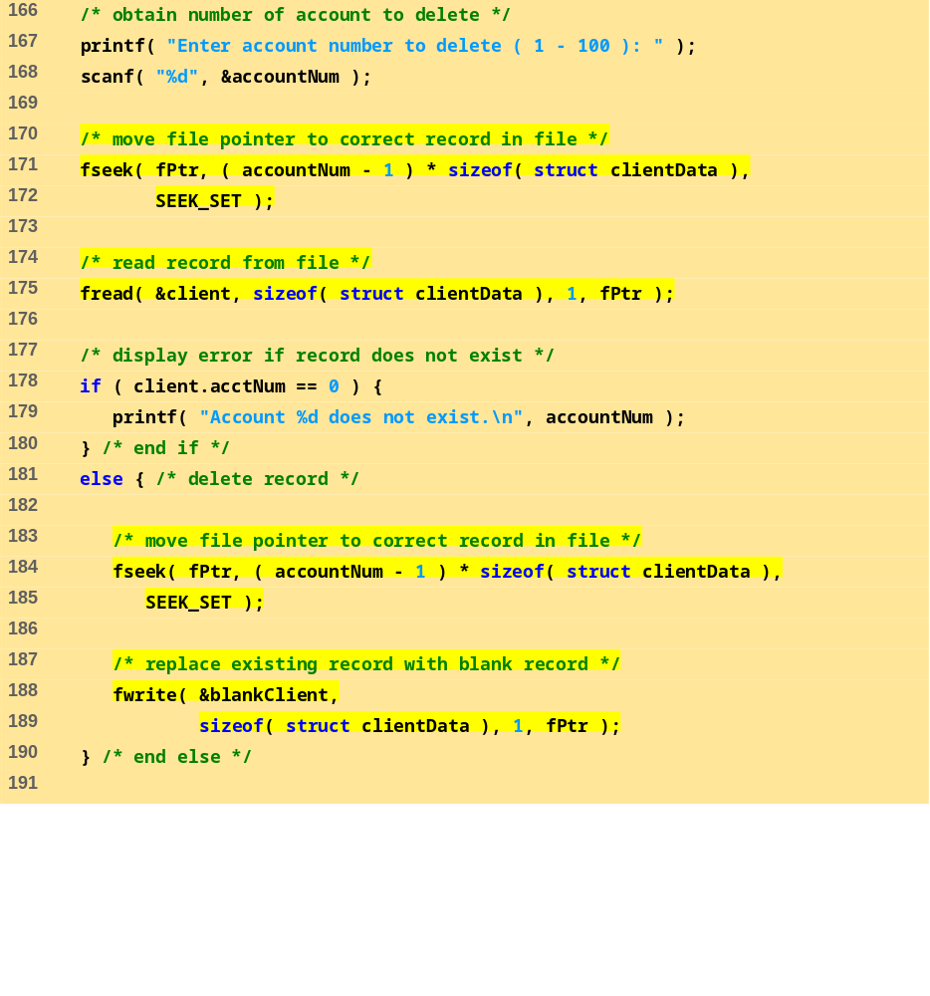
fig11_16.c (8 of 11)

Slide 50
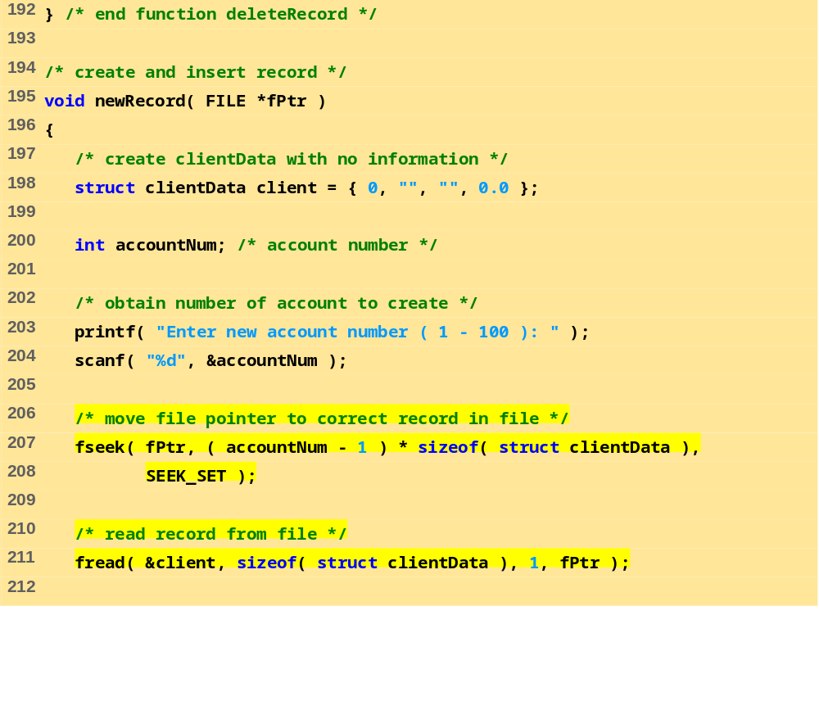
fig11_16.c (9 of 11)

Slide 51
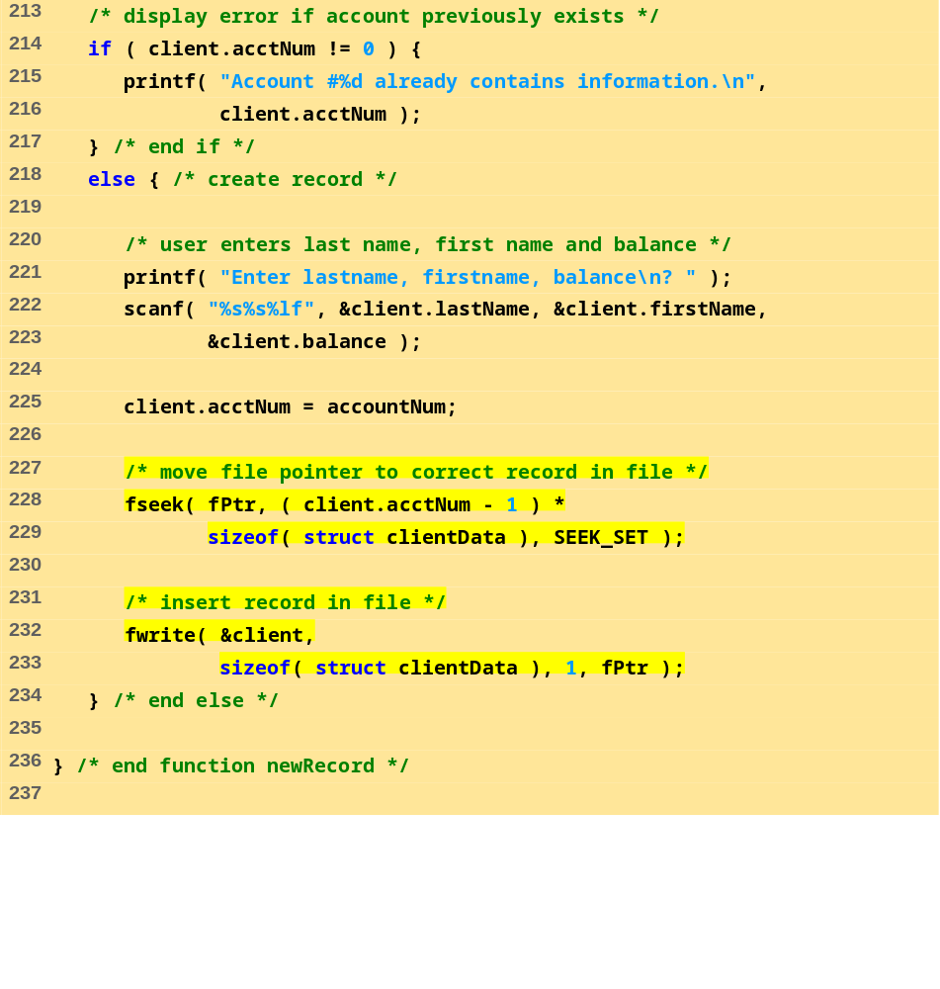
fig11_16.c (10 of 11)

Slide 52
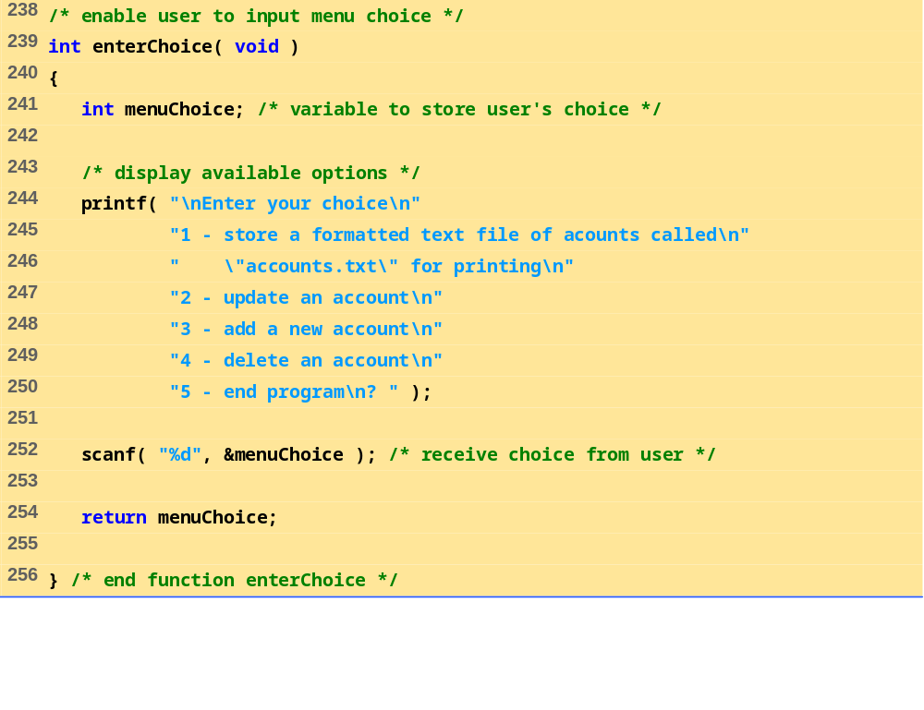
fig11_16.c (11 of 11)

Slide 53
After choosing option 1 accounts.txt contains:
Acct Last Name First Name Balance
29 Brown Nancy -24.54
33 Dunn Stacey 314.33
37 Barker Doug 0.00
88 Smith Dave 258.34
96 Stone Sam 34.98
Program Output
After choosing option 2 accounts.txt contains:
Enter account to update ( 1 - 100 ): 37
37 Barker Doug 0.00
Enter charge ( + ) or payment ( - ): +87.99
37 Barker Doug 87.99
After choosing option 3 accounts.txt contains:
Enter new account number ( 1 - 100 ): 22
Enter lastname, firstname, balance
? Johnston Sarah 247.45

